Slide 1
Automated Emergency Braking (AEB)
on Pedestrian Detection
Omkar, Radhika, Rhea, Shraddha, Sujit
CSCI 513: Autonomous Cyber Physical Systems

Slide 2
AGENDA
01
MOTIVATION
02
PROJECT TOPIC
03
SYSTEM ARCHITECTURE
04
PEDESTRIAN DETECTION using YOLO
05
SCENARIO WALKTHROUGH
06
CARLA DEMO
07
Q&A

Slide 3
Focus on Enhancing Pedestrian Safety
Addressing the risks and causes of pedestrian injuries
Advocating for infrastructure improvements and awareness to reduce pedestrian fatalities
Promote Safer Driving Practices
Encouraging drivers to stay focused, avoid distractions, and yield to pedestrians when required
Reinforcing the importance of defensive driving to prevent pedestrian accidents
Statistics
In the U.S., pedestrian deaths occur at a rate of roughly one every 64 minutes, amounting to approximately 7,500–8,000 fatalities annually [5]
Pedestrian fatalities represent a significant portion of road traffic deaths, underlining the urgent need for proactive safety measures
MOTIVATION

Slide 4
PROJECT TOPIC
Proposal: Development of an Automated Emergency Braking (AEB) System with Pedestrian Detection
Introduction:
To address the pressing issue of pedestrian safety, the implementation of Automated Emergency Braking (AEB) systems equipped with pedestrian detection technology offers a promising solution
AEB systems use sensors to monitor the vehicle's environment and, when a potential pedestrian collision is detected, can automatically apply the brakes to either avoid or mitigate the impact
Focus:
Enhancing pedestrian and vehicle safety by integrating deep learning models for pedestrian detection into the AEB system
System will be designed to detect pedestrians and trigger the brakes automatically in real-time to prevent or reduce the severity of collisions

Slide 5
SYSTEM ARCHITECTURE
An RGBA camera sensor positioned at the front of the vehicle captures images of the surrounding environment.
Car is moving and monitoring the environment for pedestrians
Pedestrian Detection using YOLOv8
Pedestrian Still in Path?
Pedestrian Detected? &&
Within Braking Distance?
CARLA Simulations
Accelerate
Apply Brakes
Pedestrian Not Detected?

Slide 6
PEDESTRIAN DETECTION using YOLO
Datasets
Models Explored
COCO (General object detection) ( ~330k images)
CrowdHuman (Human detection in crowds) ( ~15k images)
HiEve (Human detection in events) (~32k frames)
Penn-Fudan ( Pedestrian detection) ( ~170 images)
Histogram of Oriented Gradients (HOG) with Support Vector Machines (SVMs)
Faster R-CNN
YOLO (You Only Look Once)
RetinaNet
Dataset Collection
Model Building
Collected 70K images from the various datasets
Custom python scripts to filter images from datasets of size 300K-1M images
Used YOLOv8 model
Pre-calculated the weights
Tested on Penn-Fudan Dataset

Slide 7
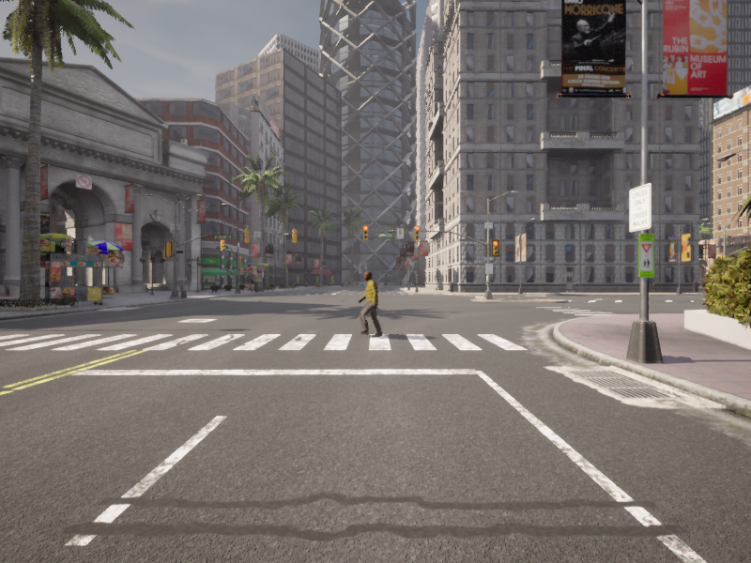
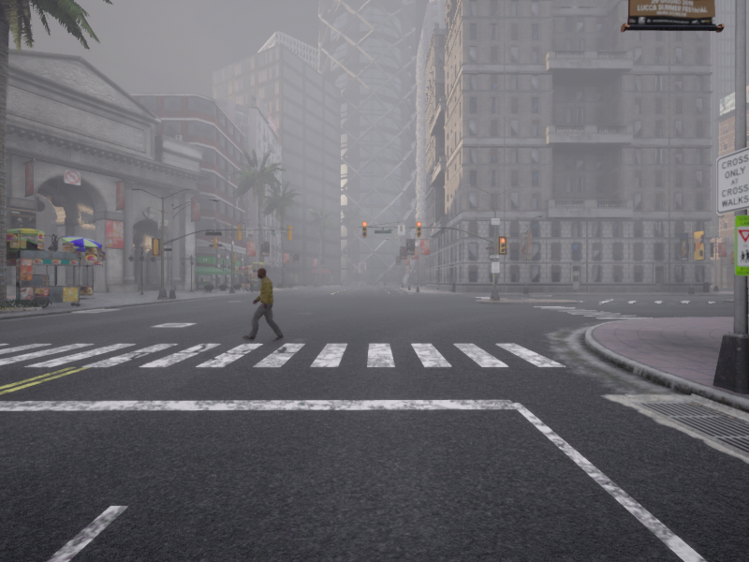
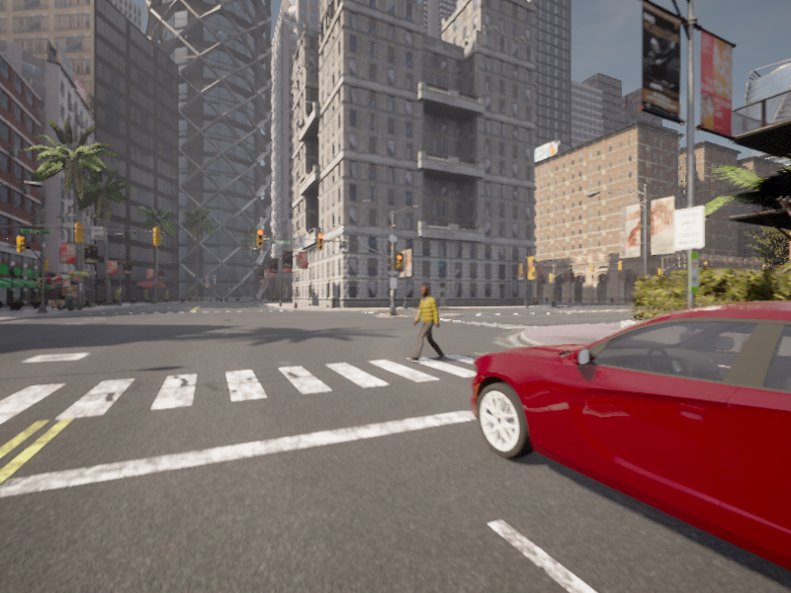
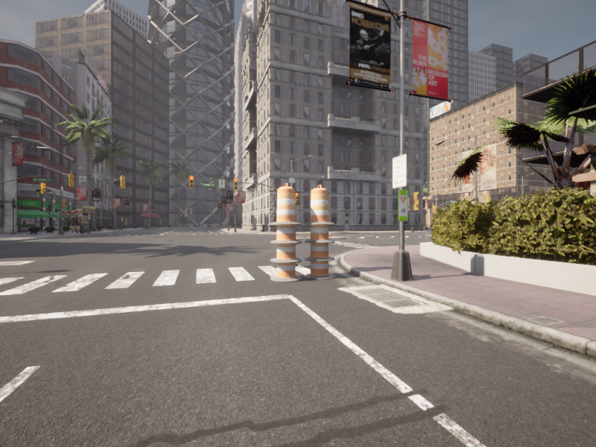
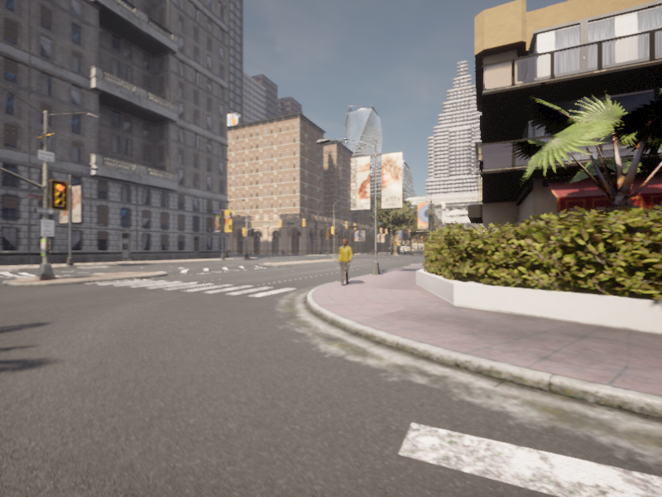
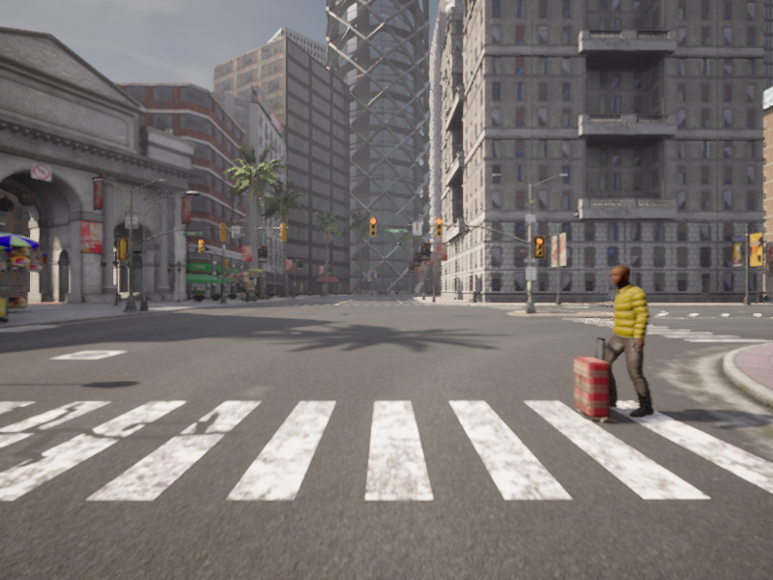
SCENARIO WALKTHROUGH
Scene 0
Scene 1
Scene 2
Car is moving on straight road and pedestrian is detected
Pedestrian Detection in low light/fog
Pedestrians occluded behind another car, who make a sudden appearance
Scene 3
Scene 4
Scene 5
Pedestrians that are visible, get occluded and then become visible again
Right turn on green light where a pedestrian is crossing
Pedestrian with strange object

Slide 8
DEMO
TIGHTEN YOUR SEAT BELTS
(VROOM VROOOOM . . .)

Slide 9
Questions?

Slide 10
THANK YOU

Slide 11
REFERENCES
[1] Ahmed S, Huda MN, Rajbhandari S, Saha C, Elshaw M, Kanarachos S. Pedestrian and Cyclist Detection and Intent Estimation for Autonomous Vehicles: A Survey. Applied Sciences. 2019; 9(11):2335. https://doi.org/10.3390/app9112335
[2] Malligere Shivanna V, Guo J-I. Object Detection, Recognition, and Tracking Algorithms for ADASs—A Study on Recent Trends. Sensors. 2024; 24(1):249. https://doi.org/10.3390/s24010249
[3] Liu G, Bei S, Li B, Liu T, Daoud W, Tang H, Guo J, Zhu Z. Research on Collision Avoidance Systems for Intelligent Vehicles Considering Driver Collision Avoidance Behaviour. World Electric Vehicle Journal. 2023; 14(6):150. https://doi.org/10.3390/wevj14060150
[4] Tan H, Zhao F, Hao H, Liu Z. Evidence for the Crash Avoidance Effectiveness of Intelligent and Connected Vehicle Technologies. International Journal of Environmental Research and Public Health. 2021; 18(17):9228. https://doi.org/10.3390/ijerph18179228
[5] Stats → https://www.cdc.gov/pedestrian-bike-safety/about/pedestrian-safety.html
[6] COCO Dataset → https://cocodataset.org/#home

